Slide 1
Unit 4- NEUROBIOLOGY
Basic of Neurons
glial cells
Brain and its parts
Artificial neural networks,-concepts, and differences with biological neural networks
uses of ANN
machine learning
data mining in biology
Notes:
1

Slide 2
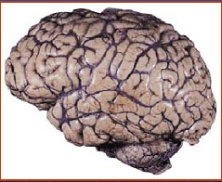
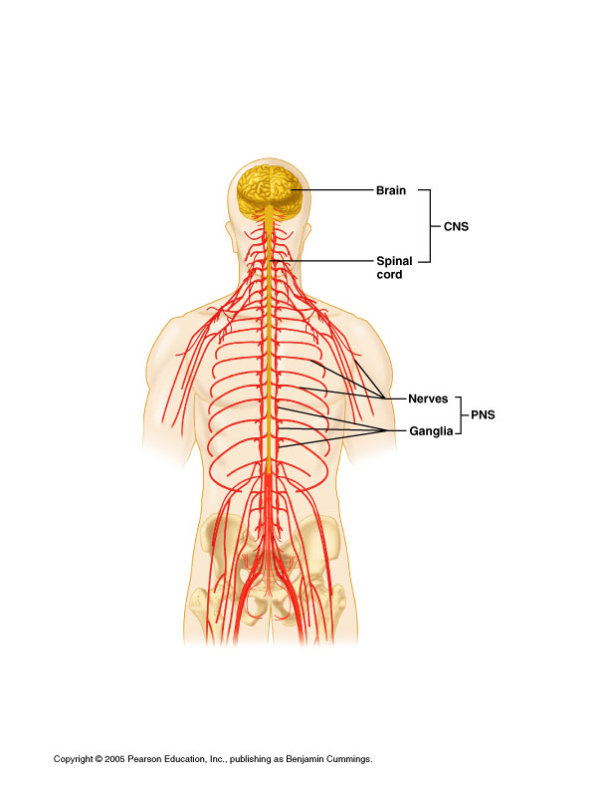
Nervous system
The task of nervous system is to coordinate the mental processes by which we perceive, act, learn and remember.
The human brain is a network of billions of individual nerve cells interconnected in systems that construct our perceptions of the external world, fix our attention, and control the machinery of our actions.
The nervous system has two classes of cells: nerve cells (neurons) and glial cells (glia).
Neurotransmitters
Neuropeptides

Slide 3
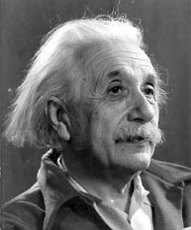
Supporting Cells (Neuroglial Cells) in the CNS
Neuroglia – usually only refers to supporting cells in the CNS, but can be used for PNS
Glial cells have branching processes and a central cell body
Outnumber neurons 10 to 1 (the guy on the right had an inordinate amount of them).
Make up half the mass of the brain
Can divide throughout life

Slide 4
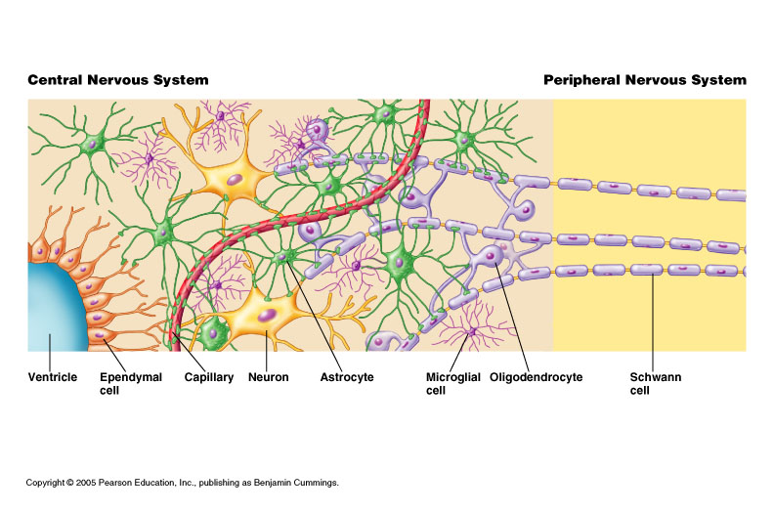
Glial cells
Glial cells are support cells.
They are more in number than neurons.
There are between 10 and 50 times more glia than neurons in the brain of humans.
The name for these cells derives from the Greek word for glue. In actual terms, the glia do not commonly hold nerve cells together but surround the neurons.

Slide 5
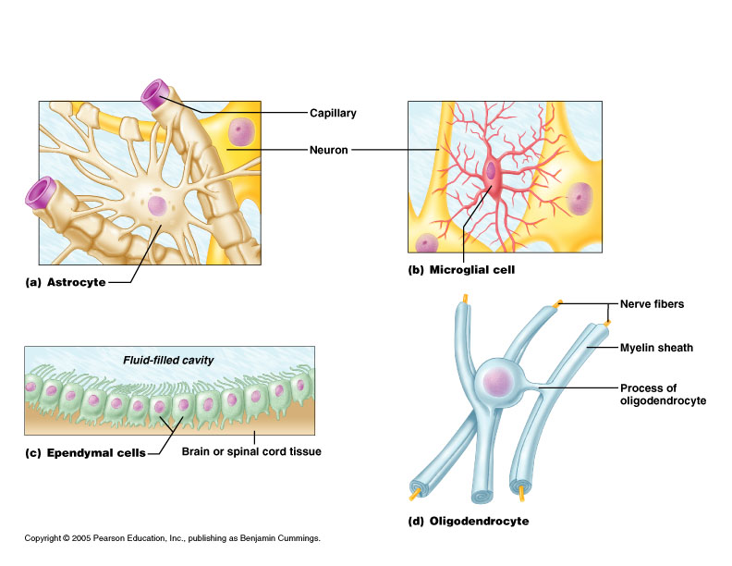
Types of Glial Cells in the CNS: Astrocytes, Oligodendrocytes, and Microglia
Astrocytes: Most abundant glial cell type, irregular star-shaped cell bodies .
Take up and release ions to control the environment around neurons
Recapture and recycle neurotransmitters
Involved with synapse formation in developing neural tissue
Produce molecules necessary for neural growth
Propagate calcium signals that may be involved in memory

Slide 6
Oligodendrocytes: Have few branches.
Wrap their cell processes around axons in CNS
Produce myelin sheaths for rapid conduction of nerve impulses
Schwann cells surround axons in the PNS and form myelin sheath around axons of the PNS

Slide 7
Microglia: Smallest and least abundant.
Phagocytes – the macrophages of the CNS
Engulf invading microorganisms and dead neurons
Derived from blood cells called monocytes

Slide 8
Nerve cells- Neurons
Nerve cells are the main signaling units of the nervous system.
A typical neuron has four morphologically defined regions: the cell body, dendrites, the axon, and presynaptic terminal
The cell body (soma) is the metabolic center of the cell. It contains the nucleus which stores the genes of the cell, as well as the endoplasmic reticulum, an extension of the nucleus where the cell’s proteins are synthesized.
The cell body gives rise to two kinds of processes: several short dendrites and one, long, tubular axon.
These processes vary in number & relative length but always serve to conduct impulses (with dendrites conducting impulses toward the cell body and axons conducting impulses away from the cell body as shown in the figure).
Notes:
8

Slide 9
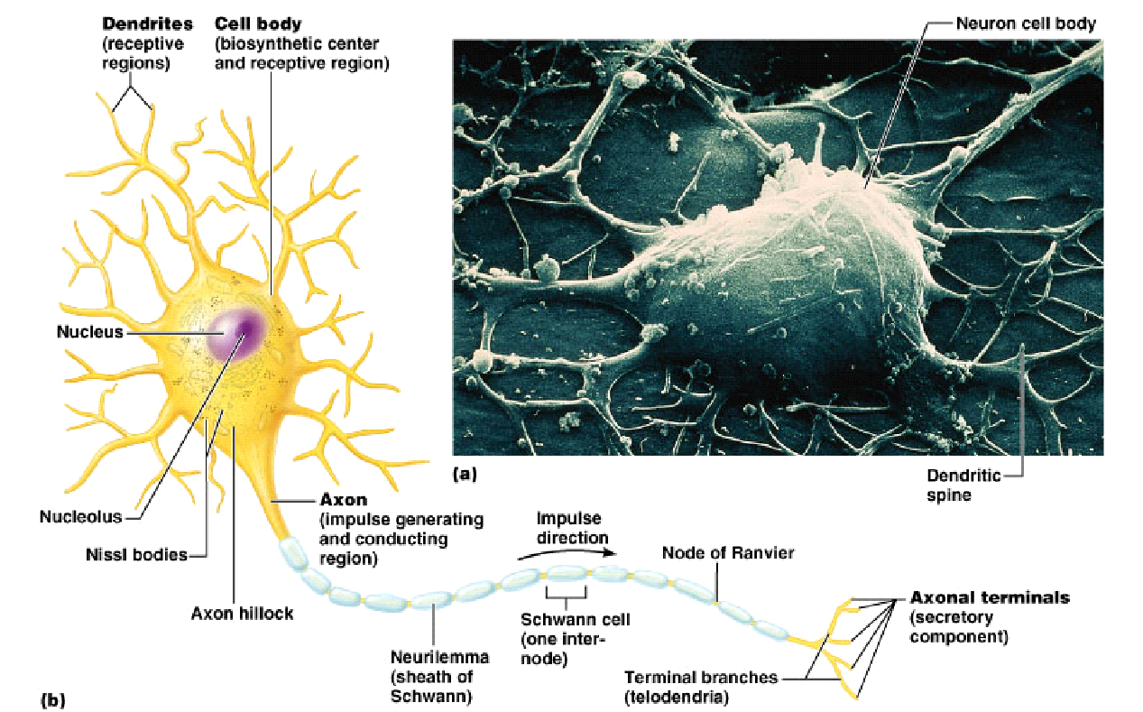

Slide 10
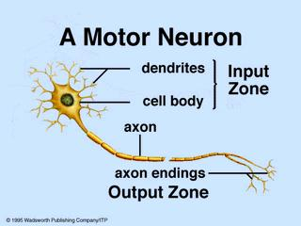
Action Potential
A neuron receives input from other neurons (typically many thousands). All the input signals are integrated. Once input exceeds a critical level, the neuron discharges a spike - an electrical pulse that travels from the body, down the axon, to the next neuron(s) (or other receptors). This spiking event is also called depolarization, and is followed by a refractory period, during which the neuron is unable to fire.

Slide 11
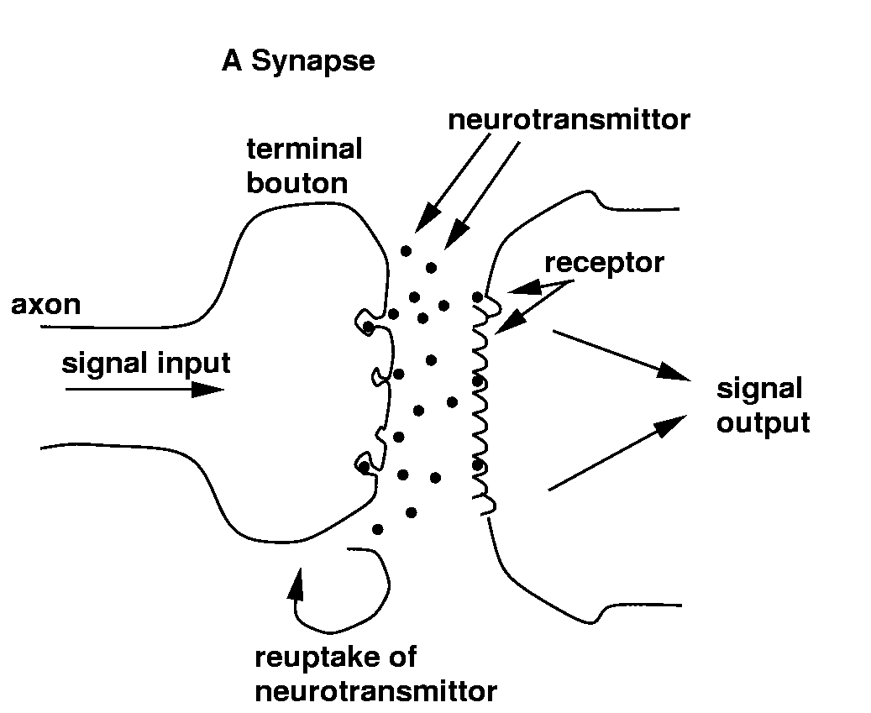
Synapse
The axon endings (Output Zone) almost touch the dendrites or cell body of the next neuron.
Transmission of an electrical signal from one neuron to the next is effected by neurotransmitters, chemicals which are released from the first neuron and which bind to receptors in the second. This link is called a synapse.
The extent to which the signal from one neuron is passed on to the next depends on many factors, e.g. the amount of neurotransmitter available, the number and arrangement of receptors, amount of neurotransmitter reabsorbed, etc.
neurotransmitter
neurotransmitter
neurotransmitter

Slide 12
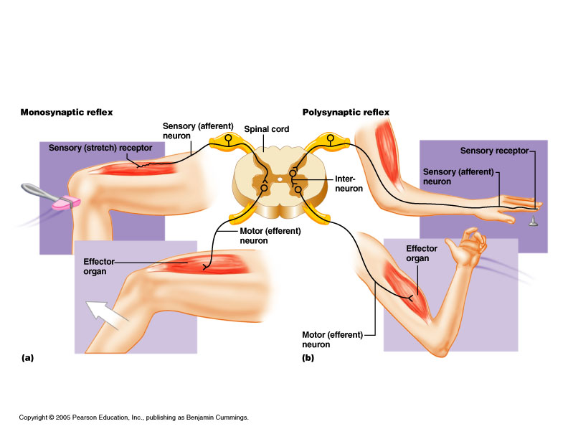
Sensory Input and Motor Output
Sensory signals picked up by sensory receptors
Carried by afferent nerve fibers of PNS to the CNS
Motor signals are carried away from the CNS
Carried by efferent nerve fibers of PNS to effectors
Innervate muscles and glands

Slide 13
Animation on nerve cells
https://www.youtube.com/watch?v=NsBaPtemAjs

Slide 14
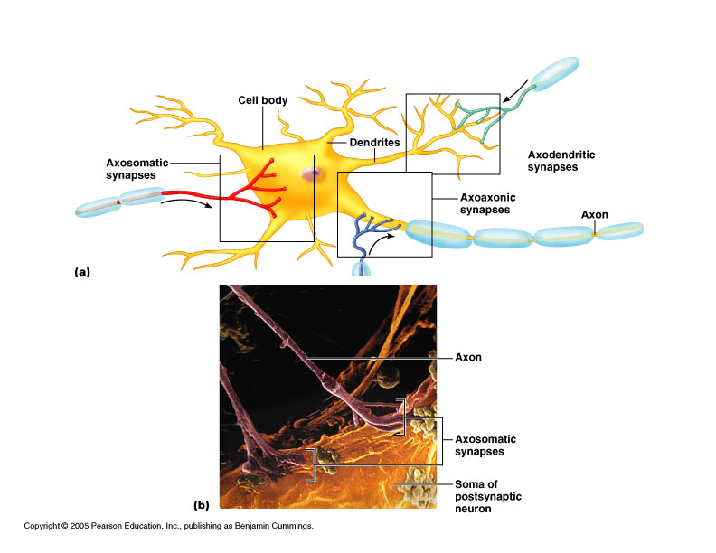
The dendrites branch out in a tree-like fashion and are the main apparatus for receiving incoming signals from other nerve cells.
In contrast, the axon extends away from the cell body and is the main conducting unit for carrying signals for other neurons.

Slide 15
An Animation for nerve impulse
https://www.youtube.com/watch?v=b2ctEsGEpe0

Slide 16
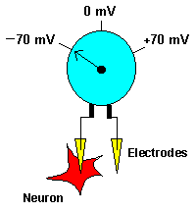
An axon can convey electrical signals along distances ranging from 0.1 mm to 3 m. These electrical signals called action potentials are rapid, transient with an amplitude of 100 mV and a duration of about 1ms.
Neurons can respond to stimuli and conduct impulses because a membrane potential is established across the cell membrane. In other words, there is an unequal distribution of ions (charged atoms) on the two sides of a nerve cell membrane.
This can be illustrated with a voltmeter: With one electrode placed inside a neuron and the other outside, the voltmeter is 'measuring' the difference in the distribution of ions on the inside versus the outside (see the adjoining figure). And, in this example, the voltmeter reads -70 mV (mV = millivolts). In other words, the inside of the neuron is slightly negative relative to the outside. This difference is referred to as the Resting Membrane Potential. It is called a RESTING potential because it occurs when a membrane is not being stimulated or conducting impulses (in other words, it's resting).

Slide 17
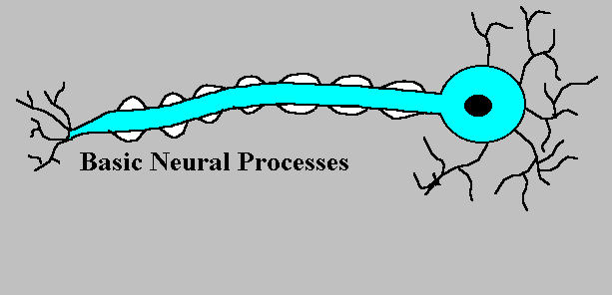
Nerve Conduction
Yes or No
Yes
Axon hillock or
Initial segment
Notes:
17
Red and green arrows represent negative and positive signals – negative signals are ones that promote the silencing of this neuron while positive signals are ones that promote the firing of this neuron
Many of these signals are repetitively given to the neuron at the same time
These signals are electrical and travel to the junction of the cell body and axons where the negative and positive signals are summed and a decision is made as to whether the neuron should fire or not – this junction is called the axon hillock or initial segment
If the decision is yes, then an impulse (spike or action potential) is generated that propagates along the axon away from the cell body toward the target neuron
When the impulse reaches the axon terminal end it causes the release of neurotransmitters into the space between the terminal and the target cell
The neurotransmitter diffuses across this space to signal the target cell

Slide 18
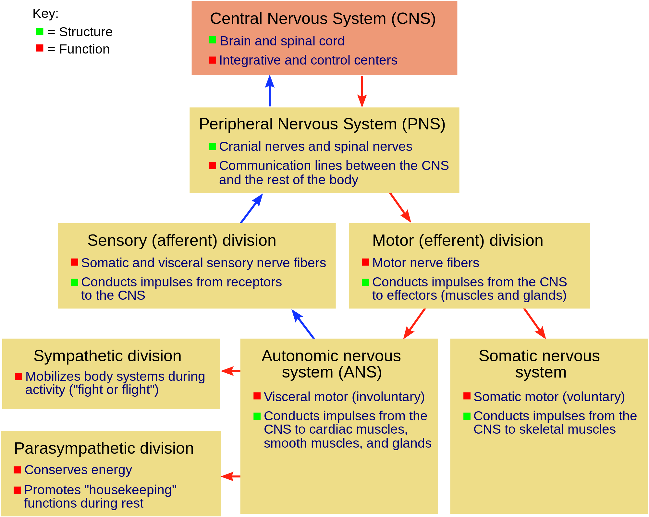

Slide 19


Slide 20
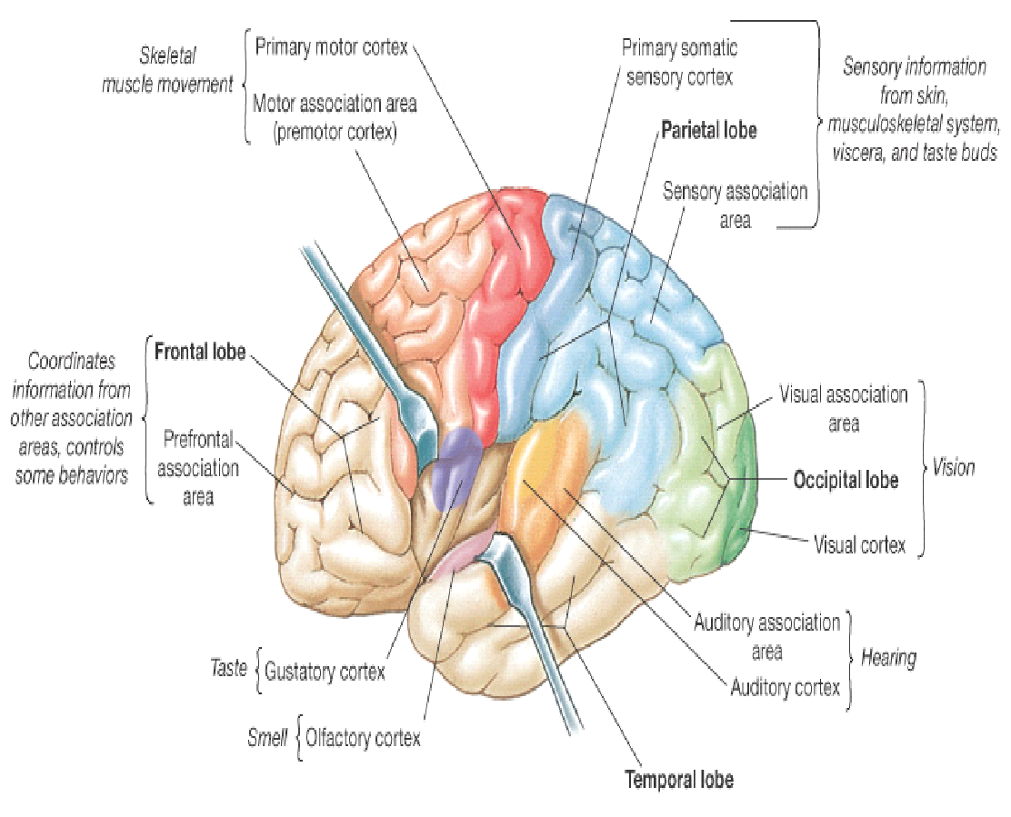
Neural Networks in the Brain
The brain is not a homogeneous organ. At the largest anatomical scale, we distinguish cortex, midbrain, brainstem, and cerebellum. Each of these can be hierarchically subdivided into many regions, and areas within each region, either according to the anatomical structure of the neural networks within it, or according to the function performed by them.
In addition to these long-range connections, neurons also link up with many thousands of their neighbors. In this way they form very dense, complex local networks:

Slide 21
Computer-based Neural Networks
The brain's network of neurons forms a massively parallel information processing system. This contrasts with conventional computers, in which a single processor executes a single series of instructions.
Despite of being built with very slow hardware, the brain has quite remarkable capabilities:
its performance tends to degrade gracefully under partial damage. In contrast, most programs and engineered systems are brittle: if you remove some arbitrary parts, very likely the whole will cease to function.
it can learn (reorganize itself) from experience.
this means that partial recovery from damage is possible if healthy units can learn to take over the functions previously carried out by the damaged areas.
it performs massively parallel computations extremely efficiently. For example, complex visual perception occurs within less than 100 ms, that is, 10 processing steps!
it supports our intelligence and self-awareness. (Nobody knows yet how this occurs.)

Slide 22
Applications of Neural Networks
Aerospace: High performance aircraft autopilots, flight path simulations, aircraft control systems, autopilot enhancements, aircraft component simulations, aircraft component fault detectors
Automotive: Automobile automatic guidance systems, warranty activity analyzers
Banking: Check and other document readers, credit application evaluators
Cognitive science: Modeling higher level reasoning, language, problem solving, Modeling lower level reasoning, vision, audition speech recognition, speech generation
Defense: Weapon steering, target tracking, object discrimination, facial recognition, new kinds of sensors, sonar, radar and image signal processing including data compression, feature extraction and noise suppression, signal/image identification
Electronics: Code sequence prediction, integrated circuit chip layout, process control, chip failure analysis, machine vision, voice synthesis, nonlinear modeling
Entertainment: Animation, special effects, market forecasting
Financial: Real estate appraisal, loan advisor, mortgage screening, corporate bond rating, credit line use analysis, portfolio trading program, corporate financial analysis, currency price prediction
Insurance: Policy application evaluation, product optimization
Manufacturing: Manufacturing process control, product design and analysis, process and machine diagnosis, real-time particle identification, visual quality inspection systems, beer testing, welding quality analysis, paper quality prediction, computer chip quality analysis, analysis of grinding operations, chemical product design analysis, machine maintenance analysis, project bidding, planning and management, dynamic modeling of chemical process systems

Slide 23
Mathematics: Nonparametric statistical analysis and regression.
Medical: Breast cancer cell analysis, EEG and ECG analysis, prosthesis design, optimization of transplant times, hospital expense reduction, hospital quality improvement, emergency room test advisement
Neurobiology: Modeling models of how the brain works, neuron-level, higher levels: vision, hearing, etc. Overlaps with cognitive folks.
Oil and Gas: Exploration
Philosophy: Can human souls/behavior be explained in terms of symbols, or does it require something lower level, like a neurally based model?
Robotics: Trajectory control, forklift robot, manipulator controllers, vision systems
Speech: Speech recognition, speech compression, vowel classification, text to speech synthesis
Securities: Market analysis, automatic bond rating, stock trading advisory systems
Telecommunications: Image and data compression, automated information services, real-time translation of spoken language, customer payment processing systems
Transportation: Truck brake diagnosis systems, vehicle scheduling, routing systems

Slide 24
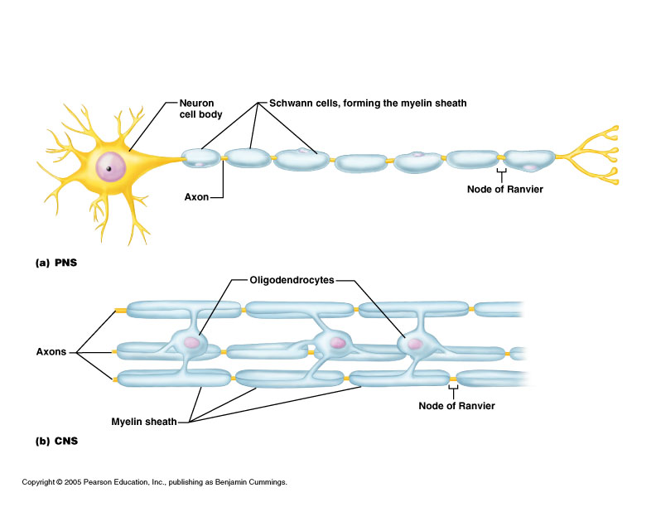
Disorders of the Nervous System
Multiple sclerosis – common cause of neural disability
Varies widely in intensity among those affected
Cause is incompletely understood
An autoimmune disease
Immune system attacks the myelin around axons in the CNS

Slide 25
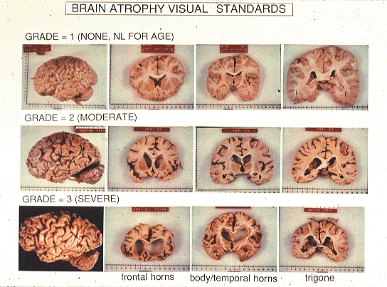

Slide 26
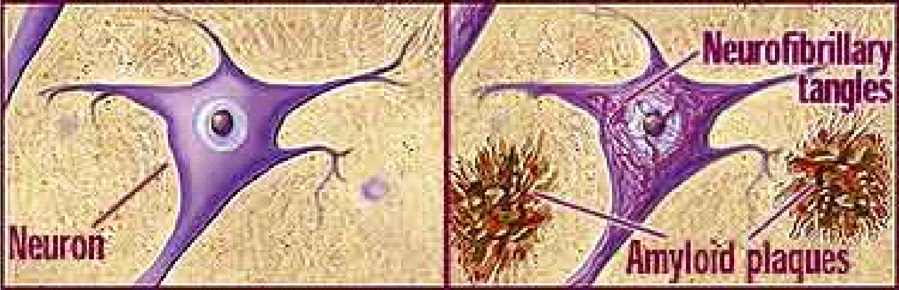

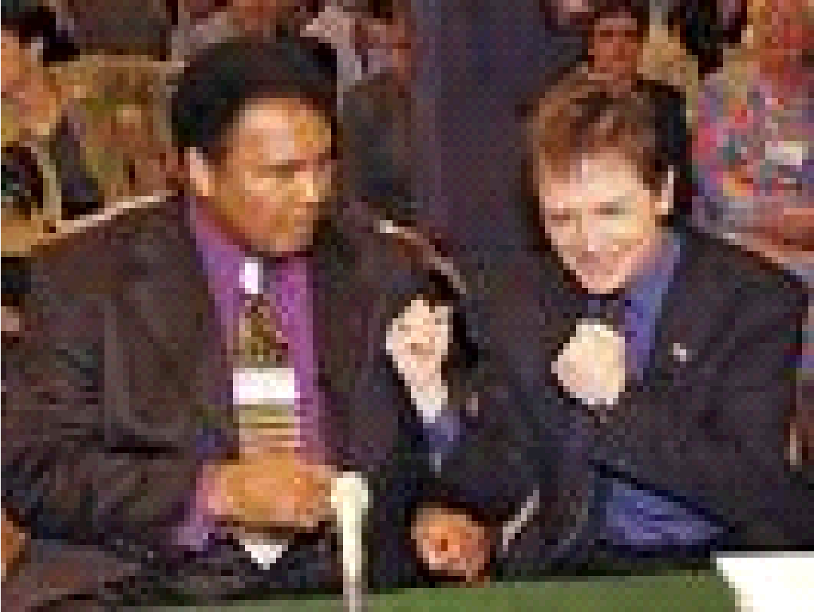
Alzheimer’s Disease:
Age-associated disorder
Loss of memory, cognition, and executive performances
Deposits of amyloid plaques and neurofibrillary tangles that interfere with neuronal functions
Loss of cholinergic neuronal functions
Parkinson’s Disease:
Age-associated disorder
Rigidity and incoordination interfering with mobility
Loss of dopaminergic neuronal functions
Alzheimer’s Disease
Parkinson’s Disease

Slide 27
List of neurodegenerative diseases
Alexander's disease
Alper's disease
Alzheimer's disease
Amyotrophic lateral sclerosis
Ataxia telangiectasia
Batten disease (also known as Spielmeyer-Vogt-Sjogren-Batten disease)
Bovine spongiform encephalopathy (BSE)
Canavan disease
Cockayne syndrome
Corticobasal degeneration
Creutzfeldt-Jakob disease
Huntington's disease
HIV-associated dementia
Kennedy's disease
Krabbe's disease
Lewy body dementia
Machado-Joseph disease (Spinocerebellar ataxia type 3)
Multiple sclerosis
Multiple System Atrophy
Narcolepsy
Neuroborreliosis
Parkinson's disease
Pelizaeus-Merzbacher Disease
Pick's disease
Primary lateral sclerosis
Prion diseases
Refsum's disease
Schilder's disease
Subacute combined degeneration of spinal cord secondary to Pernicious Anaemia
Schizophrenia
Spielmeyer-Vogt-Sjogren-Batten disease (also known as Batten disease)
Spinocerebellar ataxia (multiple types with varying characteristics)
Spinal muscular atrophy
Steele-Richardson-Olszewski disease
Tabes dorsalis

Slide 28
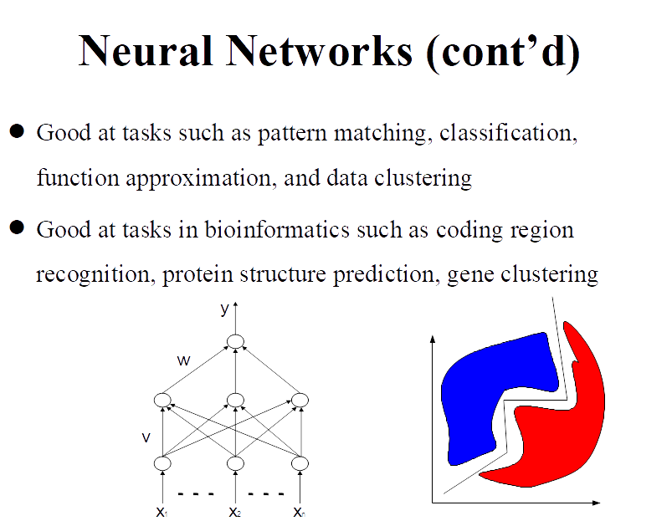

Slide 29
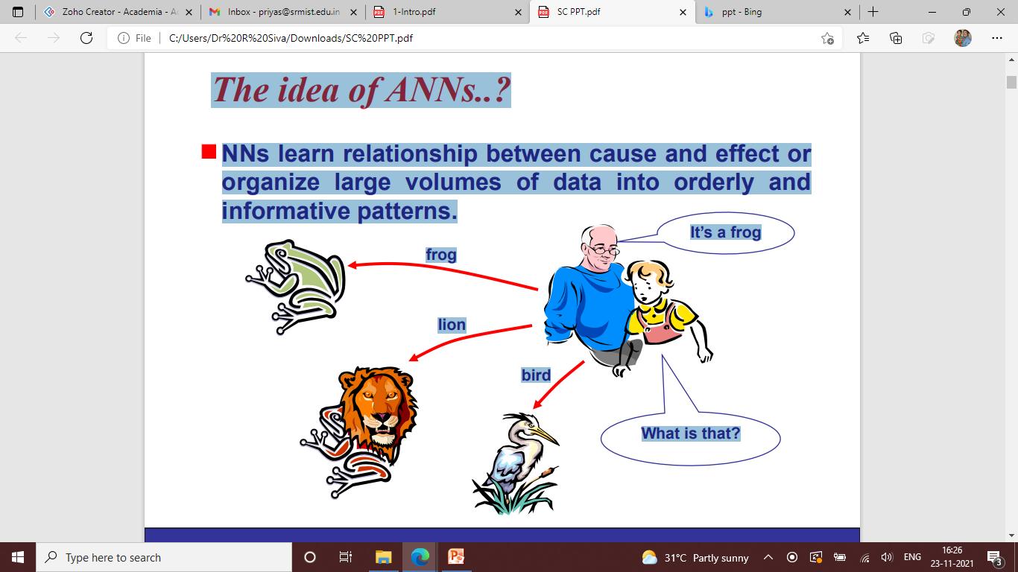

Slide 30
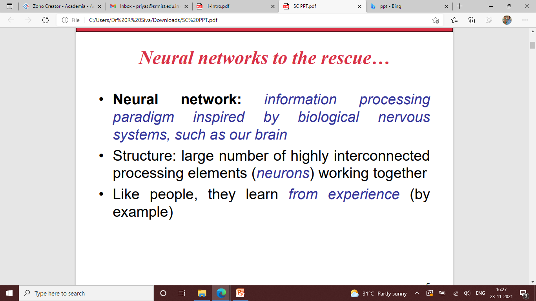

Slide 31
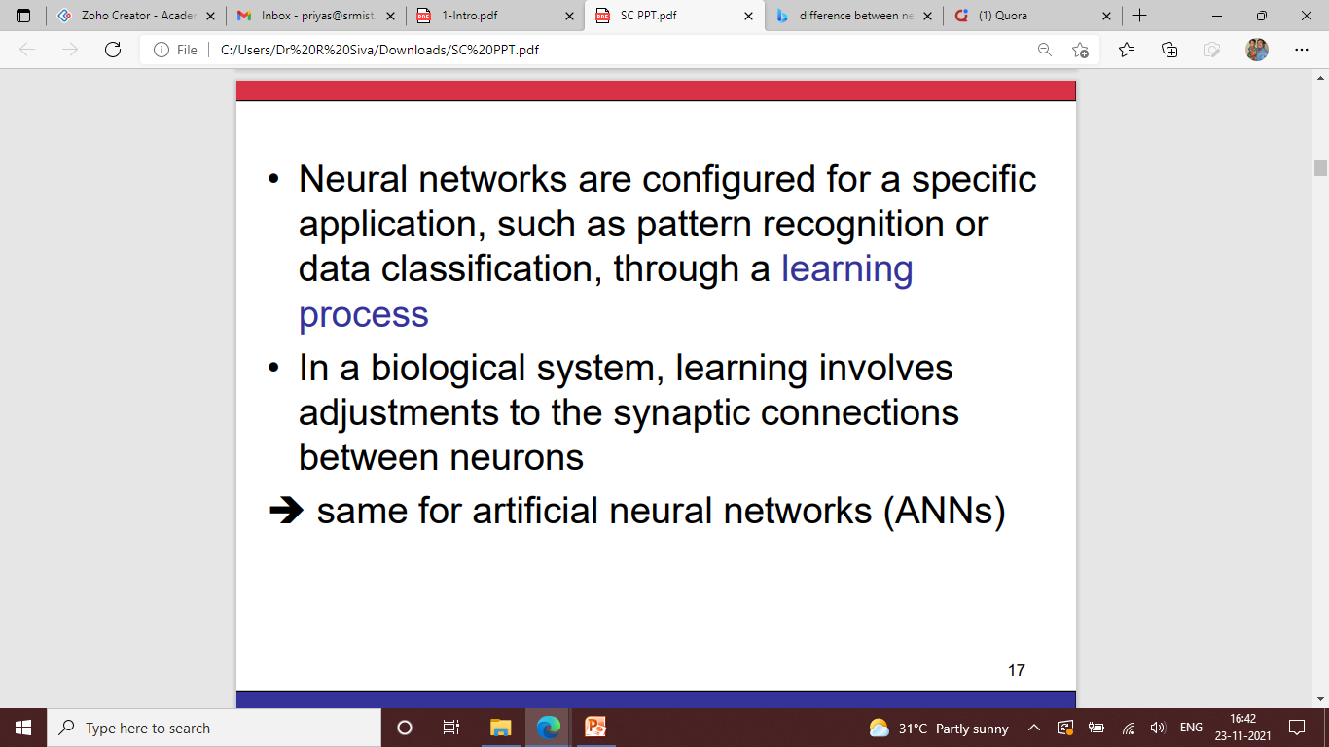

Slide 32
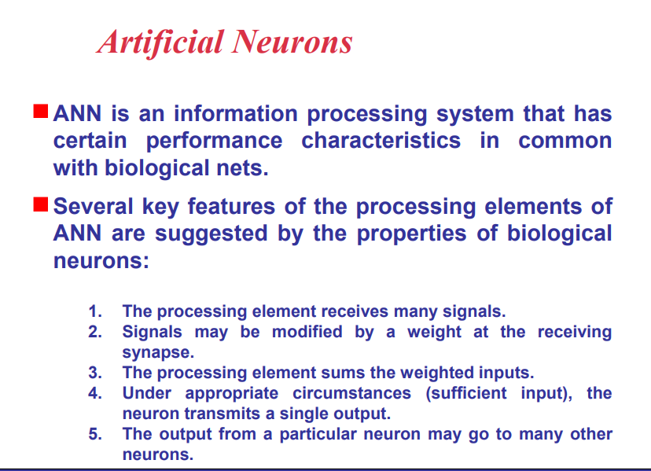

Slide 33
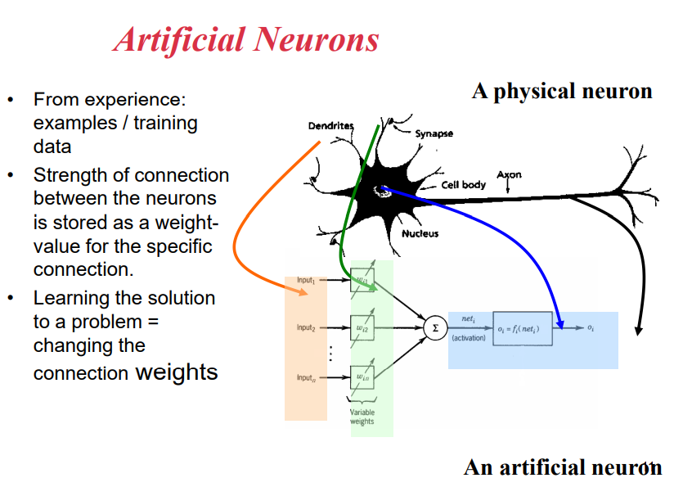

Slide 34
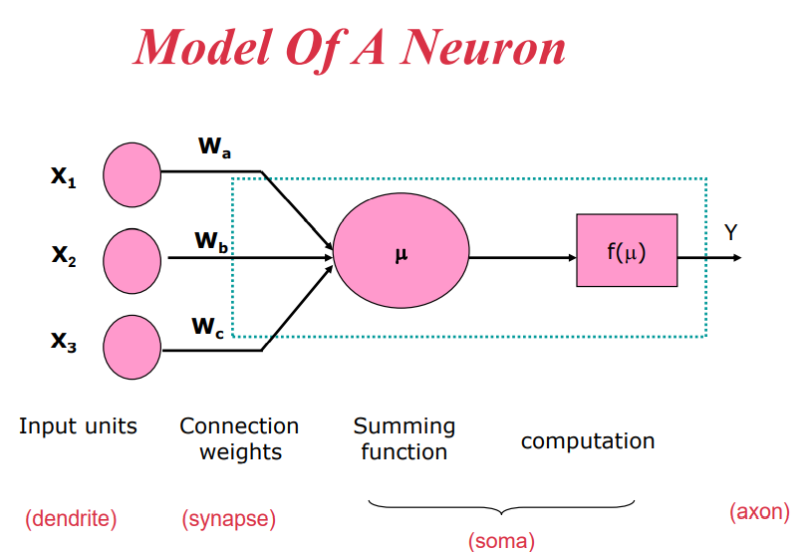

Slide 35
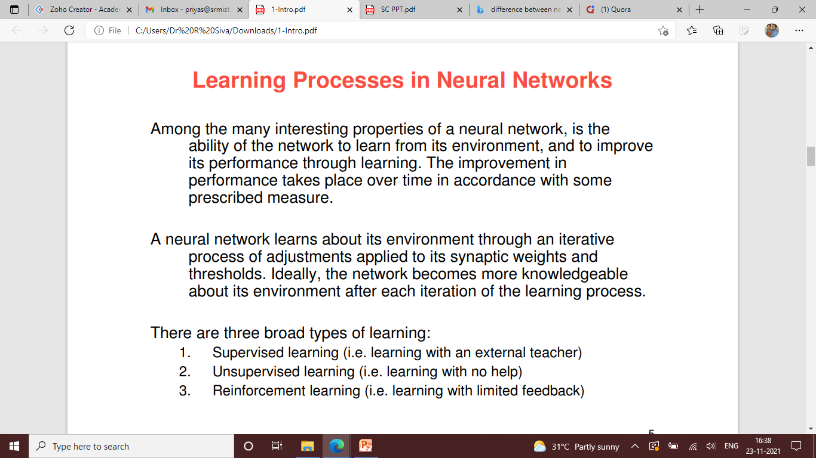

Slide 36
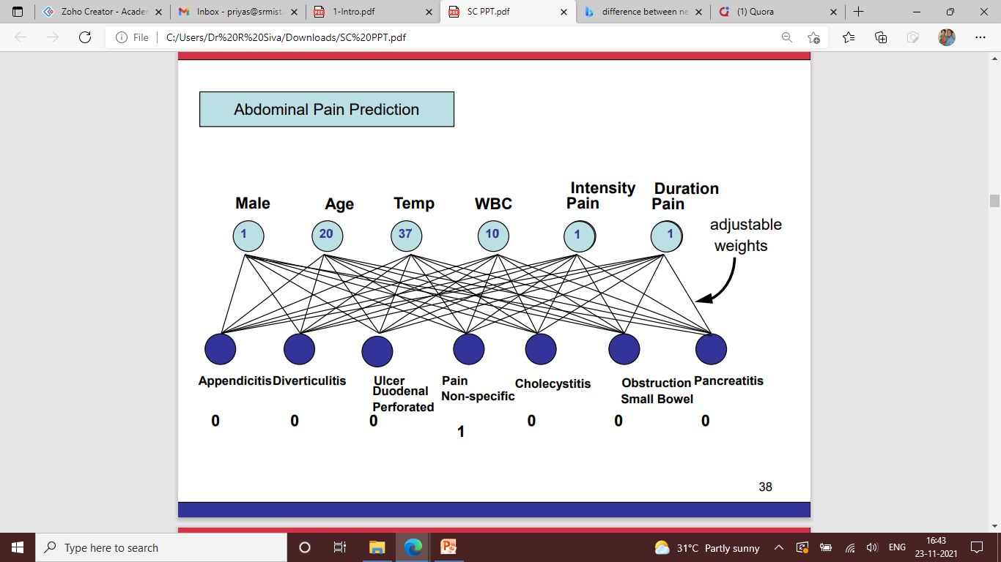
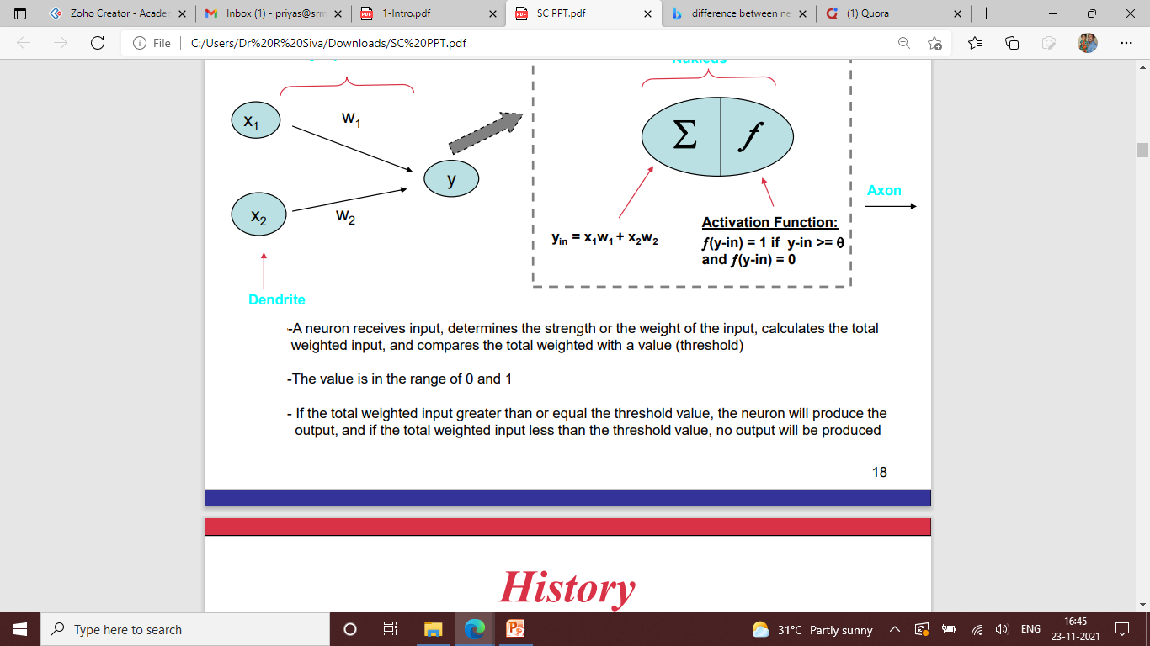

Slide 37
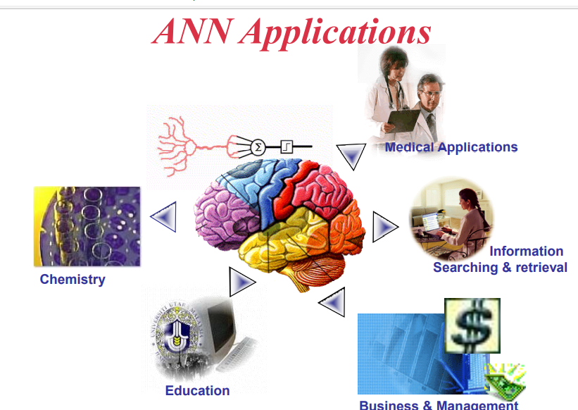

Slide 38
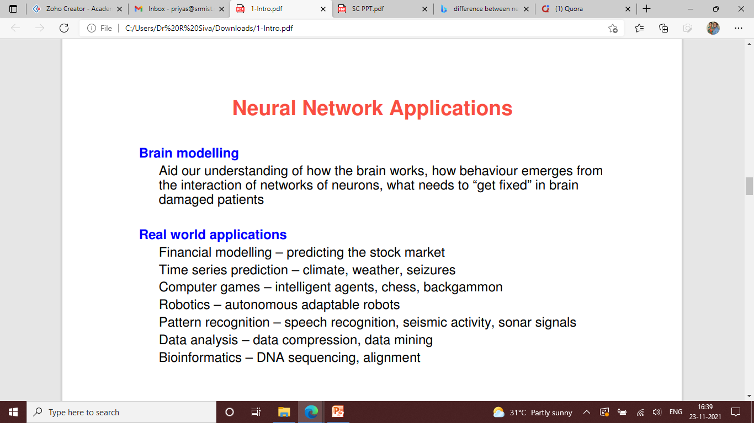

Slide 39
MACHINE LEARNING
Machine Learning is the field of study that gives computers the capability to learn without being explicitly programmed.
Machine learning and statistics are closely knit.

Slide 40
TYPES
Supervised machine learning algorithms require external assistance.
The external assistance is usually through a human expert who provides curated input for the desired output to predict accuracy in algorithm training.
The expert or data scientist determines the features or patterns that the model would use. Once the training is completed, then it can be applied to test another data for the prediction and classification. It is supervised because the algorithm learns from the training data set akin to a teacher supervising the learning process of a student
e.g., decision tree, support vector machine, and neural network.

Slide 41
TYPES
Unsupervised learning algorithms infer patterns from data without a dependent variable or known labels.
In unsupervised learning algorithms no external assistance is required.
The computer program automatically searches the feature or pattern form the data and groups them into clusters.
When we introduce new data for the prediction, then it uses previously learned features to classify the data. This method is very useful in the era of big data because it requires huge amount of training data.
E.g.,Clustering and principle component analysis

Slide 42
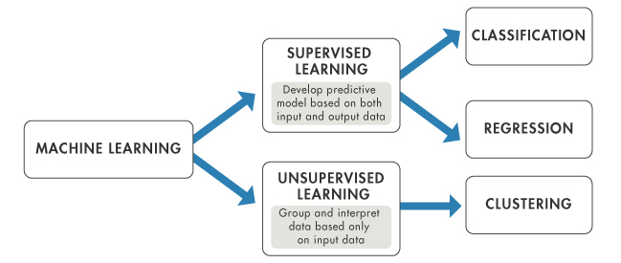
Regression and Classification are types of supervised learning algorithms while Clustering is a type of unsupervised algorithm.

Slide 43
Regression
When the output variable is continuous, then it is a regression problem whereas when it contains discrete values, it is a classification problem
The ultimate goal of the regression algorithm is to plot a best-fit line or a curve between the data. The three main metrics that are used for evaluating the trained regression model are variance, bias and error
Notes:
43

Slide 44
Classification
For any given input, the classification algorithms help in the prediction of the class of the output variable. There can be multiple types of classifications like binary classification, multi-class classification, etc. It depends upon the number of classes in the output variable.
The classification techniques help make predictions about the target values’ category based on any input provided. Usually, the term “classification” is used to narrate the predictive modeling in which the sample annotation is definite.

Slide 45
Clustering
Clustering is a type of unsupervised machine learning algorithm. It is used to group data points having similar characteristics as clusters.
the data points in the same cluster should exhibit similar properties and the points in different clusters should be as dissimilar as possible.

Slide 46
 | SUPERVISED LEARNING | UNSUPERVISED LEARNING
Input Data | Uses Known and Labeled Data as input | Uses Unknown Data as input
Computational Complexity | Very Complex | Less Computational Complexity
Real Time | Uses off-line analysis | Uses Real Time Analysis of Data
Number of Classes | Number of Classes are known | Number of Classes are not known
Accuracy of Results | Accurate and Reliable Results | Moderate Accurate and Reliable Results

Slide 47
Deep Learning
Deep learning is a more recent subfield of machine learning that is the extension of neural network. In deep learning “deep” refers to the number of layers through which data is transformed. So, deep learning is similar to neural network with multi-layers. These multi-layers nodes try to mimic how the human brain thinks to solve the problems.

Slide 48
Applications of ML
The ML algorithms are used for selecting relevant features in biological data which are high dimensional in nature
The second major application of ML in biology has been found in classification of biological data
Third major ML application in bioinformatics is clustering of biological data like gene data

Slide 49
Examples of Application of ML
Structure prediction of proteins-the use of machine learning in structure prediction has pushed the accuracy from 70% to more than 80%.
Stroke diagnosis- Machine learning methods for the analysis of neuroimaging data are used to help diagnose stroke. Historically multiple approaches to this problem involved neural networks.
Machine learning and AI are being used extensively by hospitals and health service providers to improve patient satisfaction, deliver personalized treatments, make accurate predictions and enhance the quality of life. It is also being used to make clinical trials more efficient and help speed up the process of drug discovery and delivery

Slide 50
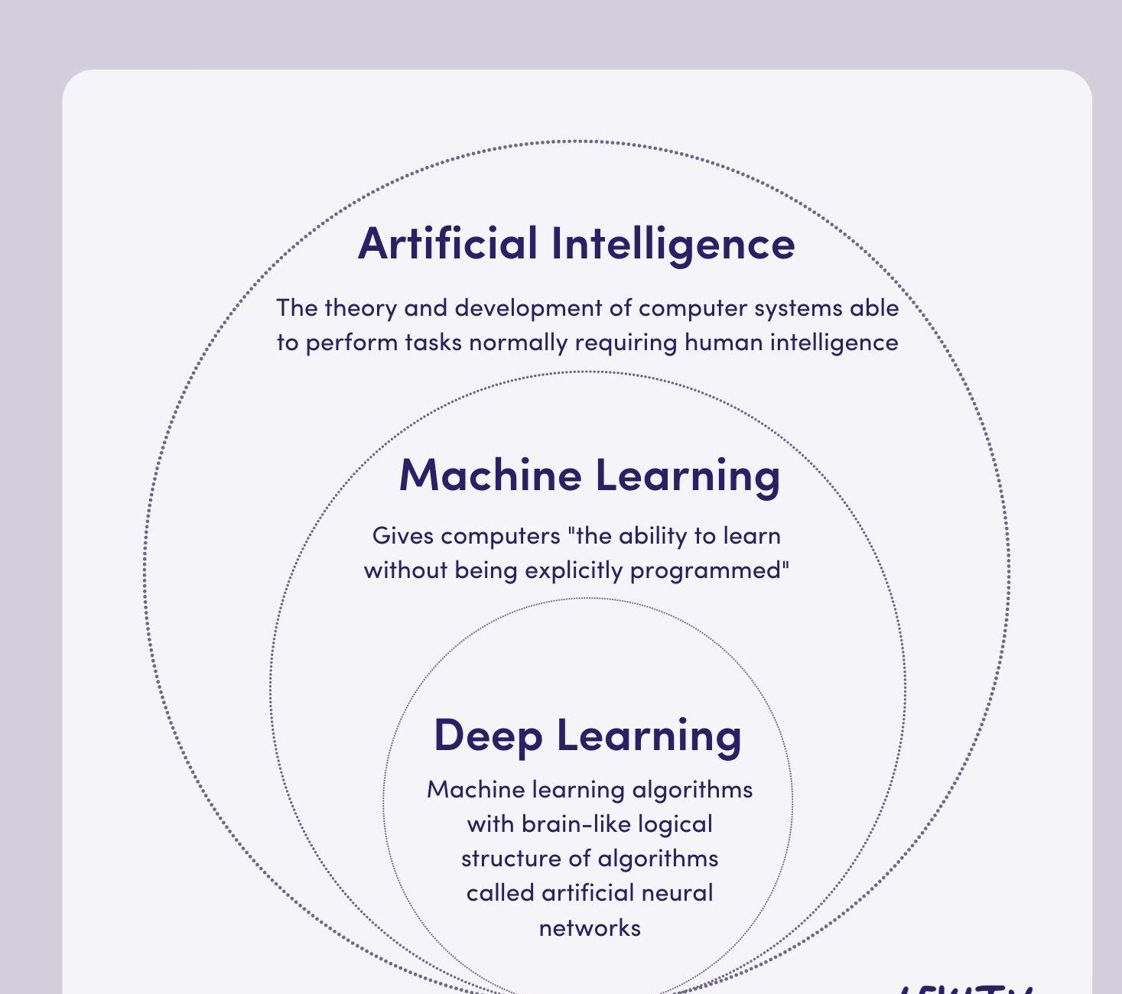

Slide 51
DATAMINING IN BIOLOGY

Slide 52
Data mining refers to extracting or “mining” knowledge from large amounts of data. Data Mining (DM) is the science of finding new interesting patterns and relationship in huge amount of data.
It is defined as “the process of discovering meaningful new correlations, patterns, and trends by digging into large amounts of data stored in warehouses”.
Data mining is also sometimes called Knowledge Discovery in Databases (KDD). Data mining is not specific to any industry. It requires intelligent technologies and the willingness to explore the possibility of hidden knowledge that resides in the data.

Slide 53
primary goals of data mining, in practice,
prediction and description.
The main tasks well suited for data mining, all of which involves mining meaningful new patterns from the data, are:
Classification: Classification is learning a function that maps (classifies) a data item into one of several predefined classes.
Estimation: Given some input data, coming up with a value for some unknown continuous variable.
Prediction: Same as classification & estimation except that the records are classified according to some future behaviour or estimated future value).
Association rules: Determining which things go together, also called dependency modeling.
Clustering: Segmenting a population into a number of subgroups or clusters.
Description & visualization: Representing the data using visualization techniques.

Slide 54
Case study: DATAMINING in DIABETES
Diabetes is the most common endocrine disease across all population and age groups.
This disease has become the fourth leading cause of death in developed countries and there is substantial evidence that it is reaching epidemic proportions in many developing and newly industrialized nations
Regression analysis was done on data available in WHO for diabetes patients of different age groups and their treatments
The effect of available treatments on younger and older population was predicted
Cited from: Abdullah A. Aljumah, Mohammed Gulam Ahamad, Mohammad Khubeb Siddiqui,Application of data mining: Diabetes health care in young and old patients,Journal of King Saud University - Computer and Information Sciences,Volume 25, Issue 2,2013,Pages 127-136, https://doi.org/10.1016/j.jksuci.2012.10.003

Slide 55
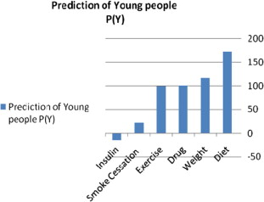
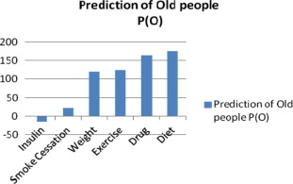
The young age group, p(y), is predicted to have a preferential order of treatment namely diet control, weight control, drug treatment, exercise treatment, smoke cessation, and finally, insulin.
The preferential order of modes of treatment for old age group patients, p(o), differs from p(y). The predictions indicated here are diet control, drug treatment, exercise, weight control, smoking cessation, and finally, insulin.

Slide 56
THANKYOU

